Slide 1
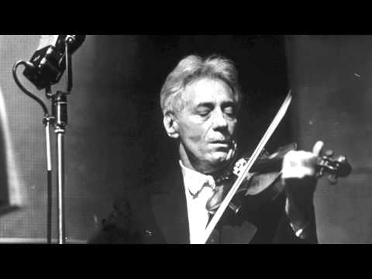
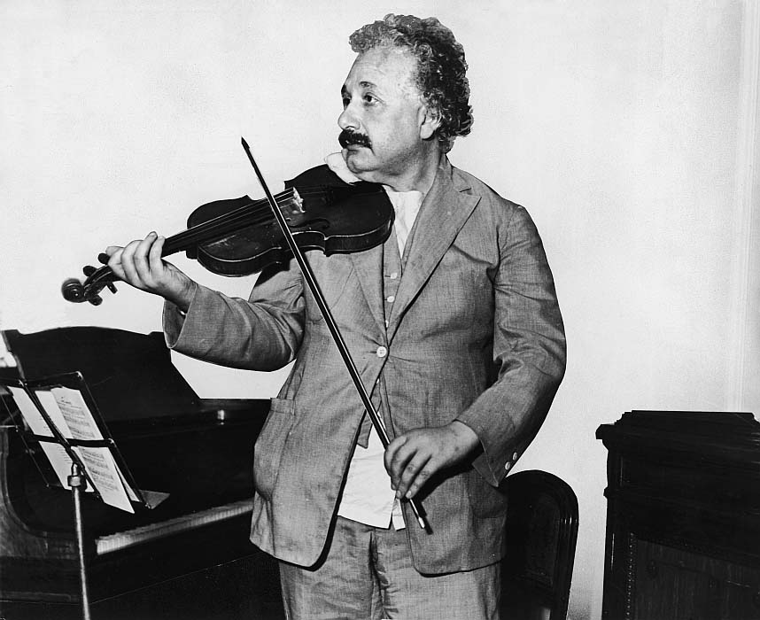
Simulation of string profiles of bowed instruments
Emanuel Casiano-Diaz

Slide 2
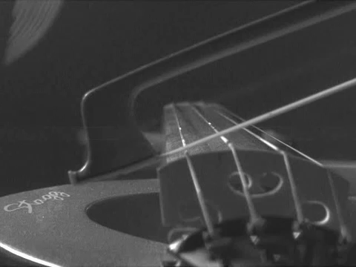
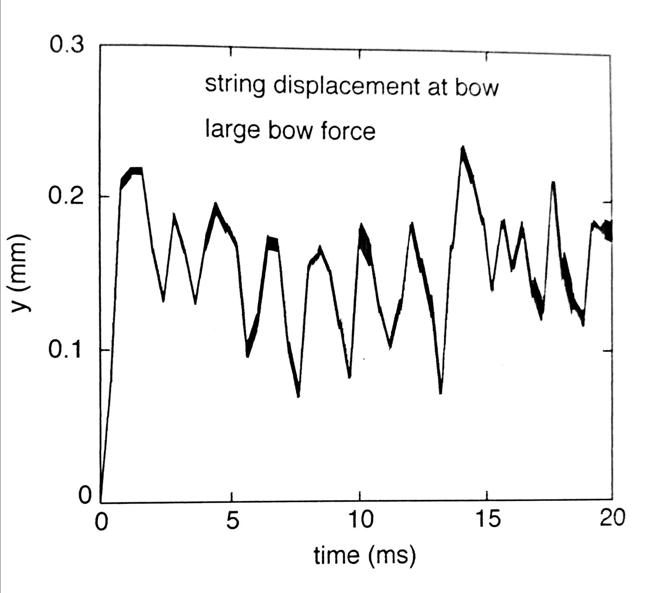
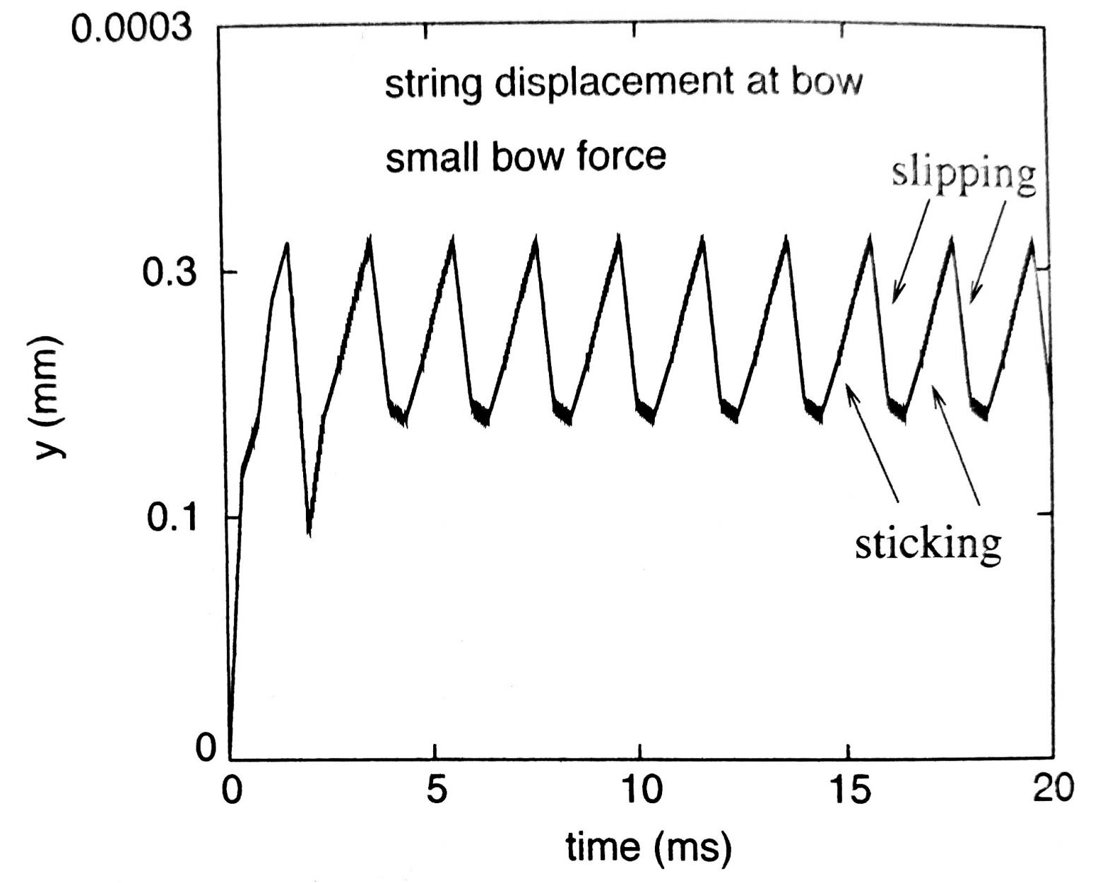

Goals:
Simulate the string profiles of bowed instruments at different times
Using the Slip-Stick Model
Study the effect of varying the velocity of the bow and the normal force applied
Find suitable conditions for Helmholtz Motion
Progress:
Worked out the argument to support Helmholtz motion
Conclusion $f_{bow}=f_{freeString}$
Began writing code to get string profiles
BAD!
GOOD!

